Slide 1
Supplementary slides for chapter 12

Slide 2
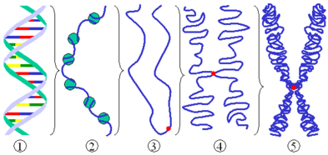


Slide 3
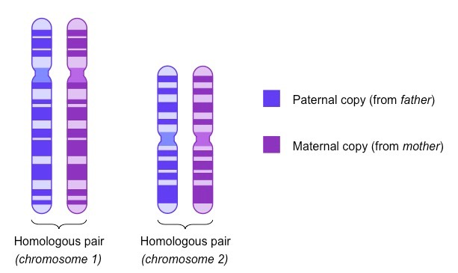
Same size
Same banding pattern
Same set of genes

Slide 4
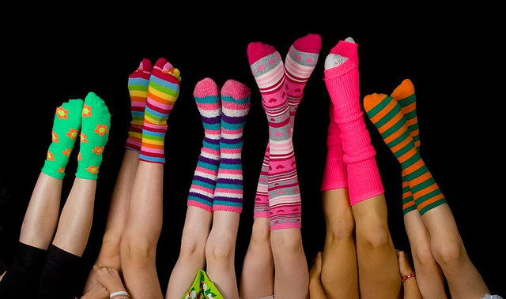
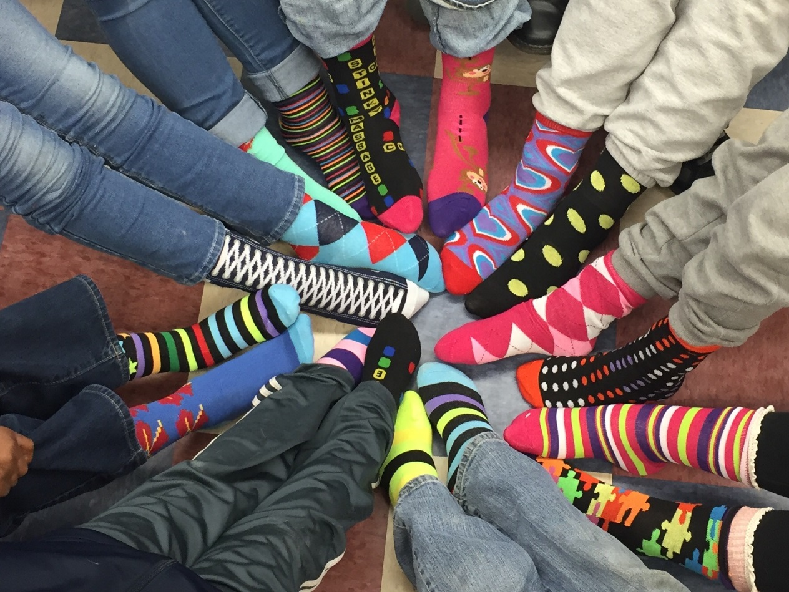
diploid
haploid

Slide 5
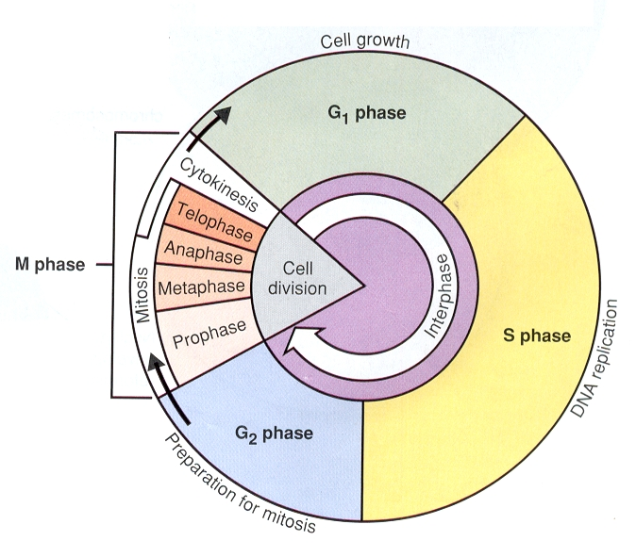
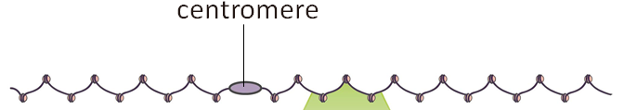
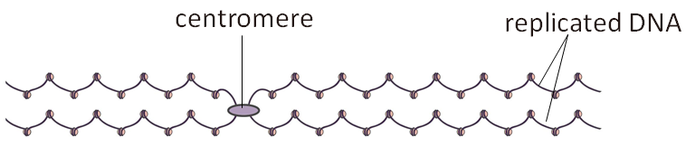
The Mitotic Cell Cycle
cell cycle can be regarded as alternating the mitotic phase with the interphase (90% of time of a cell cycle)
Most of the time, the cell performs the task for which it has been pre-programmed during differentiation

Slide 6
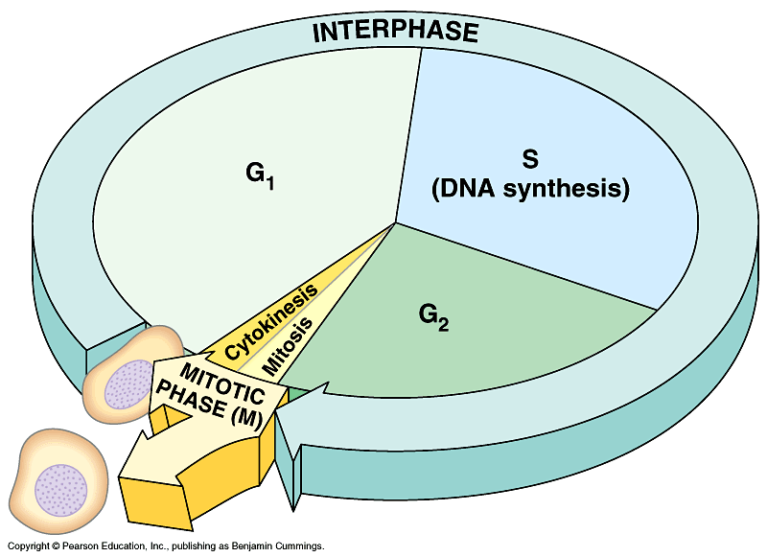
The cell cycle
(Growth, functioning)
(Growth, functioning)

Slide 7
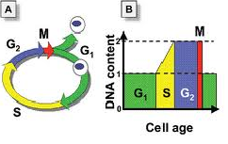
Cell cycle:
Interphase >Nuclear division >Cytoplasmic division

Slide 8
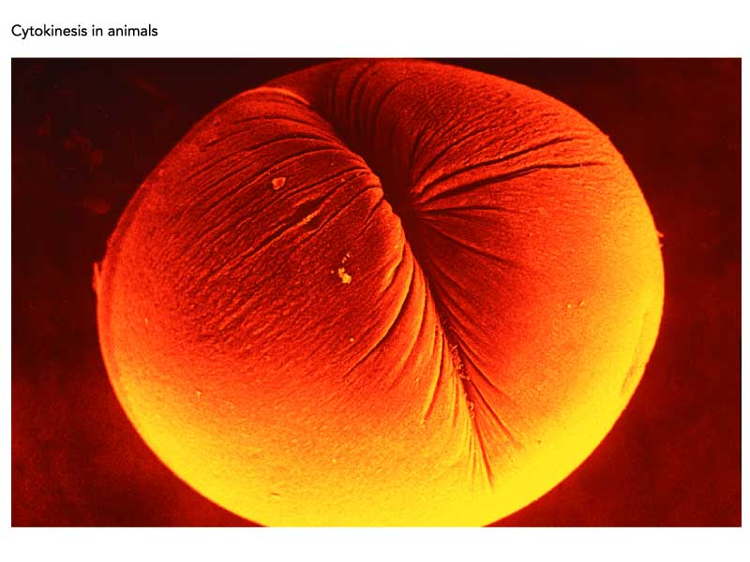
cell

Slide 9
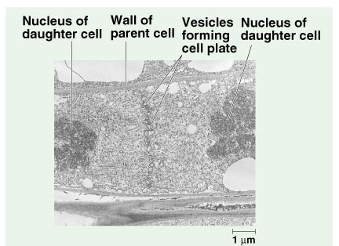

Slide 10
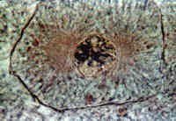
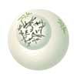
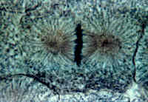
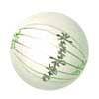
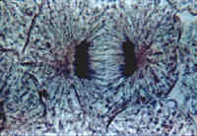
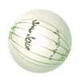
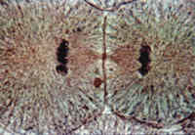
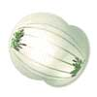
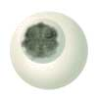
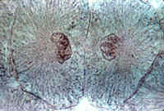
Chromosome appear, each chromosome consists of 2 identical chromatids, nuclear membrane disappears
Mitotic cell division
Chromosomes line up at the middle of the cell
Chromatids separate and move to the opposite poles of the cell
Resting stage (carry out function normally)
Cytoplasm in the middle part pinches inwards, forming 2 daughter cells
chromatin
Chromosome gradually disappear, nuclear membrane is formed
growth

Slide 11
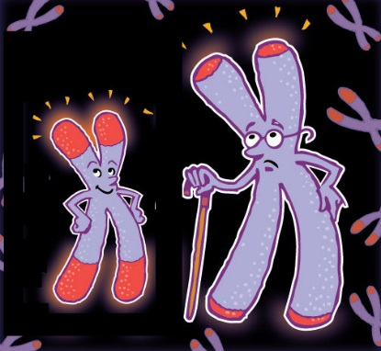
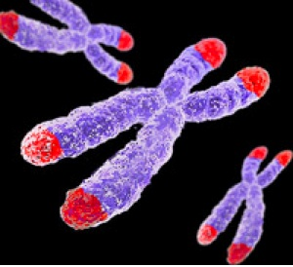
Aging and telomeres
Telomeres are small strand of
DNA found at the end of each
chromosome that protect and
prevent harm to the DNA
contained within. Every time cells divide a small portion of the telomere is lost. After a certain numbers of division the telomere becomes so short that it prevents the DNA information of the chromosome to replicate and cells begin to degrade and eventually die.
The red ends show regions
of telomeres in a chromosome.

Slide 12
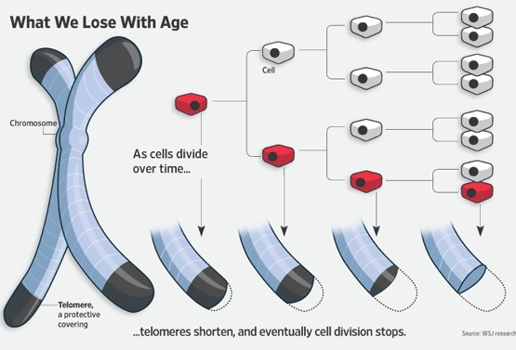

Slide 13
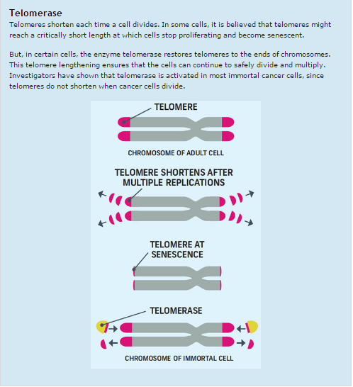

Slide 14
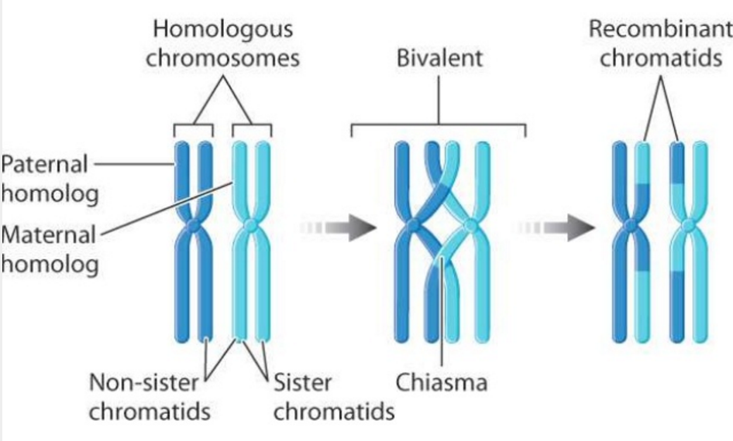
Some examples:

